Slide 1

Online shopping system
- Tejaswini Talekar (Team champion)

Slide 2
content
1. Introduction
2. Tables and ERD
3. Create DB
4. Create Tables
5. SQL Functions
JOINS
Subqueries
User Privileges
Commit, Rollback and Savepoints
Stored Procedures
Triggers
View
Backup

Slide 3
Introduction
In the presentation, we will go through the basic SQL implementation of Functions, Procedures, Subqueries, Triggers and views.

Slide 4
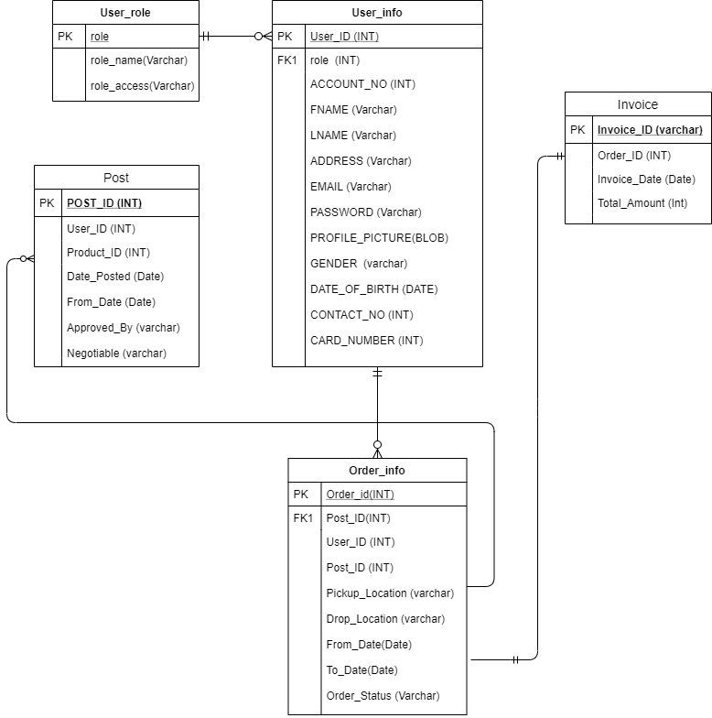
ERD

Slide 5
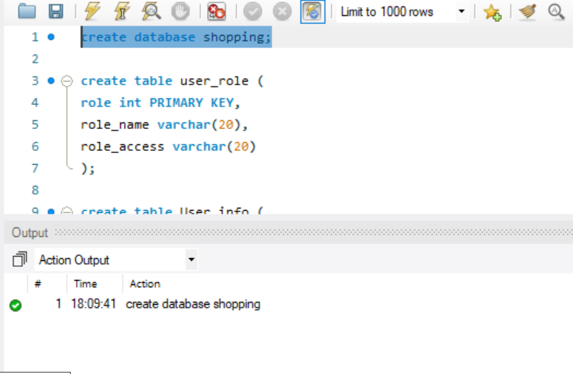
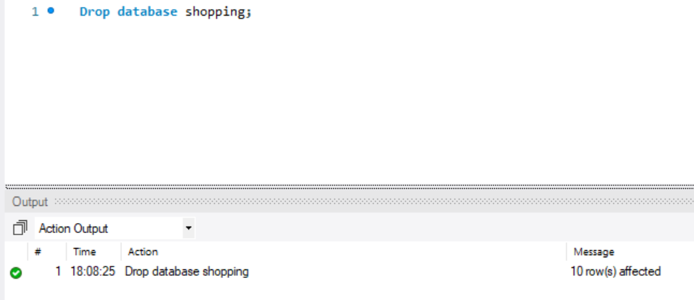
Set 1: create DB, Use db and drop db

Slide 6
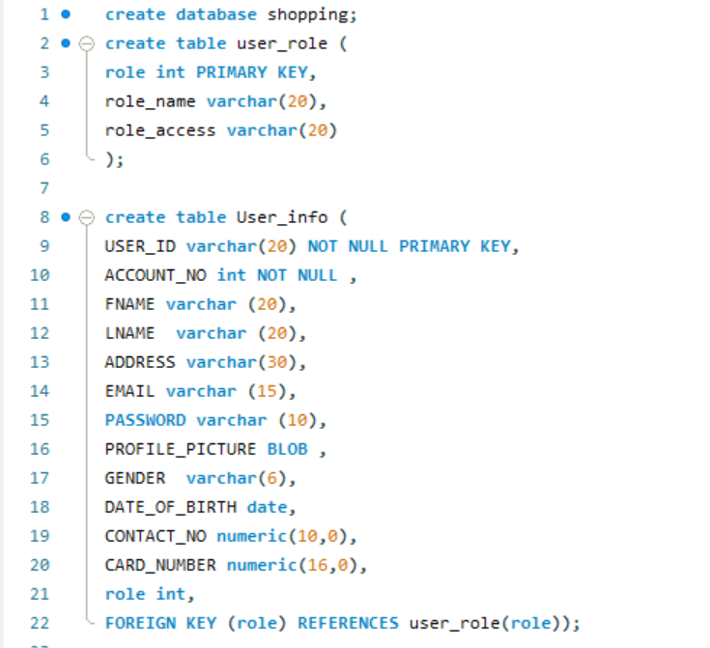
SET 2: Create tables and demonstration of different data types
This will create a database shopping
The first table created was user_role where role is a primary key
Created another table User_info, which will store all the information related touser

Slide 7
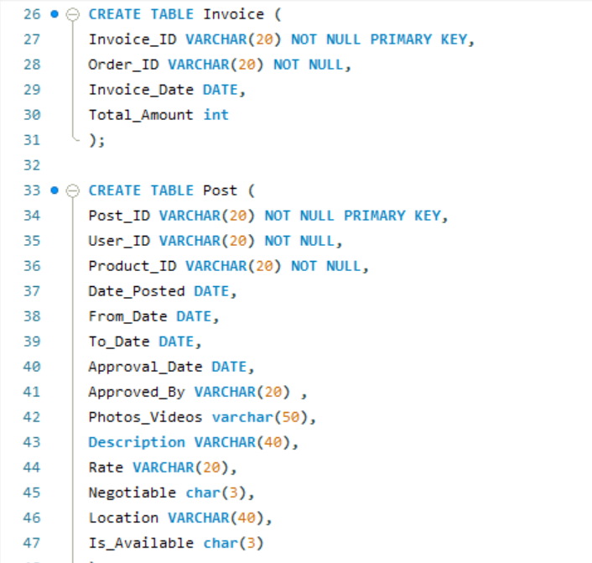
SET 2: Create tables and demonstration of different data types
Table Invoice : to store the purchase history and to show the total amount of order purchased by the user
Table Post: The online post of the product

Slide 8
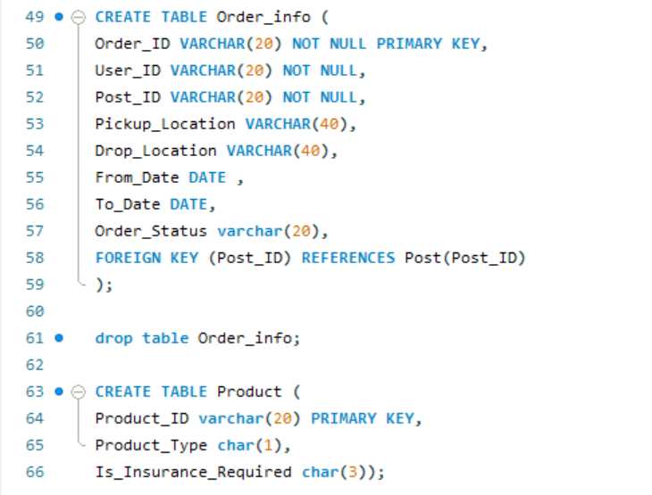
SET 2: Create tables and demonstration of different data types
Table Order_info: To store the details of the order placed by the user
Table Product: Product catlog containing all the products

Slide 9
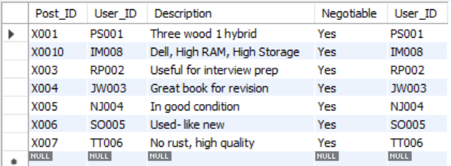
Set 3 : Select – From – Where – Group By – Having - Order By – Limit
Select Post_ID, User_ID,Description,Negotiable, User_ID from post where Negotiable = 'Yes' group by User_ID;

Slide 10
Between, like
select * from user_info where DATE_OF_BIRTH between '1994-01-01' and '1997-01-01' order by DATE_OF_BIRTH;
select * from user_info where FNAME like '%n' having GENDER = 'Male';

Slide 11
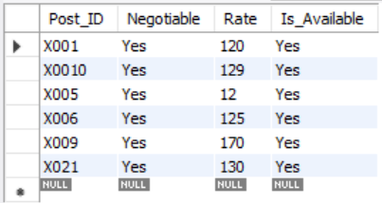
Combing queries
select Post_ID, Negotiable,Rate,Is_Available from post where Negotiable = 'Yes' and Rate < 200 and Is_Available='Yes’;

Slide 12
Limit, Is not null
select * from order_info where Order_Status = 'Completed' limit 1;
select * from post where Approved_By IS NOT NULL;

Slide 13
join
A SQL Join statement is used to combine data or rows from two or more tables based on a common field between them. Different types of Joins are:
INNER JOIN
LEFT JOIN
RIGHT JOIN
FULL JOIN

Slide 14
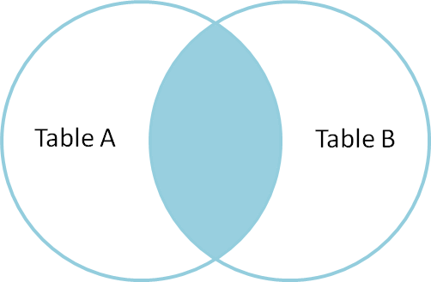
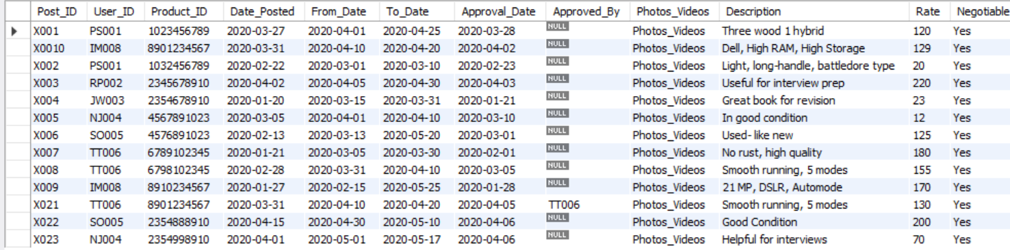
Inner join
Select Post.*, User_info.*From Post INNER JOIN User_info ON Post.User_ID = User_info.User_ID;

Slide 15
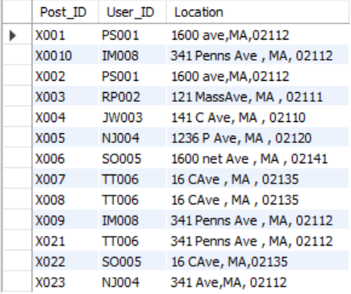
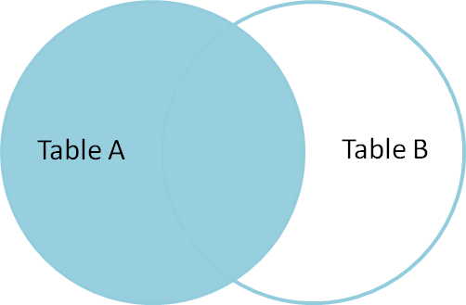
Leftjoin
select Post.Post_ID, User_info.User_ID, Post.LocationFrom Post LEFT JOIN User_info ON Post.User_ID = User_info.User_ID;

Slide 16
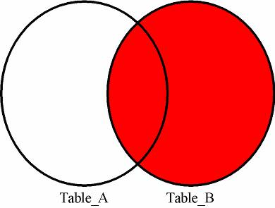
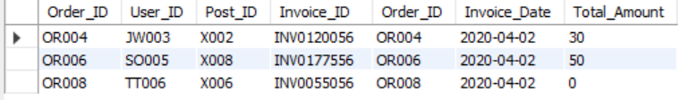
Right join
Select o.Order_ID, o.User_ID, o.Post_ID , i.*From order_info oRight JOIN invoice i ON o.Order_ID = i.Order_ID order by o.Order_ID;

Slide 17
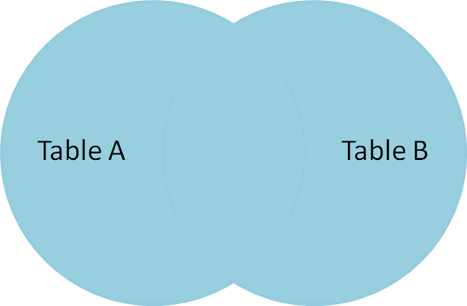
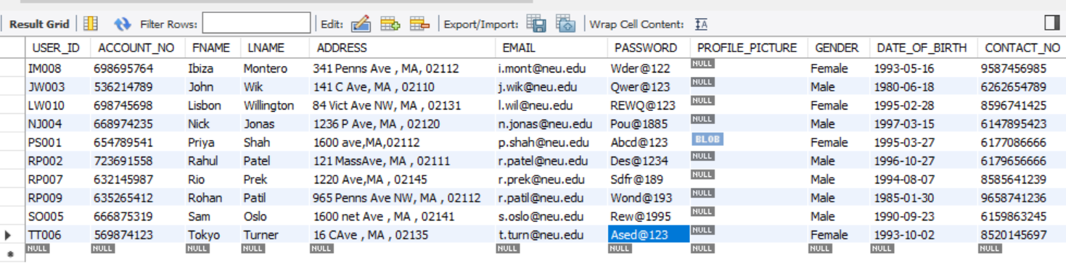
Full join
Select r.*, u.User_IDFrom User_role rFULL OUTER JOIN User_info u ON r.role = u.role;

Slide 18
Subqueries
select * from User_info where User_id in (Select User_ID from post where Approval_Date > '2019-12-12') and gender = 'female'order by role ;

Slide 19
Privileges
Privileges: Privileges defines the access rights provided to a user on a database object. There are two types of privileges.
For example: To grant CREATE TABLE privilege to a user by creating a testing role
First, create a testing Role
Second, grant a CREATE TABLE privilege to the ROLE testing. You can add more privileges to the ROLE.
GRANT CREATE TO ‘testing@localhost’;

Slide 20
User privilages
Object Privileges | Description
INSERT | allows users to insert rows into a table.
SELECT | allows users to select data from a database object.
UPDATE | allows user to update data in a table.
EXECUTE | allows user to execute a stored procedure or a function.

Slide 21
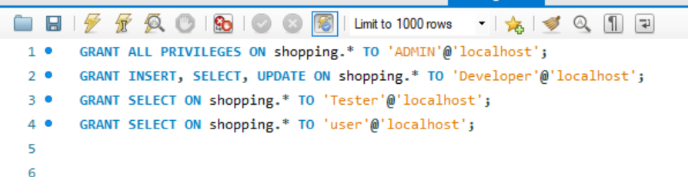
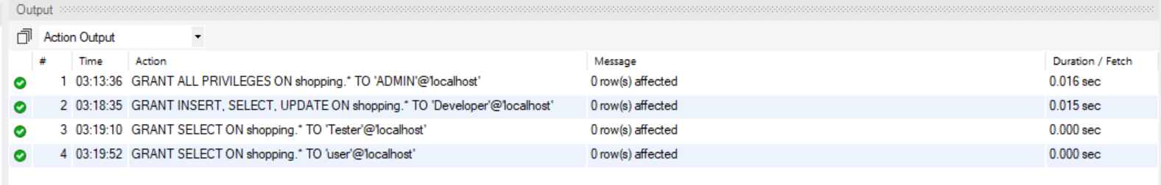
Grant privileges

Slide 22
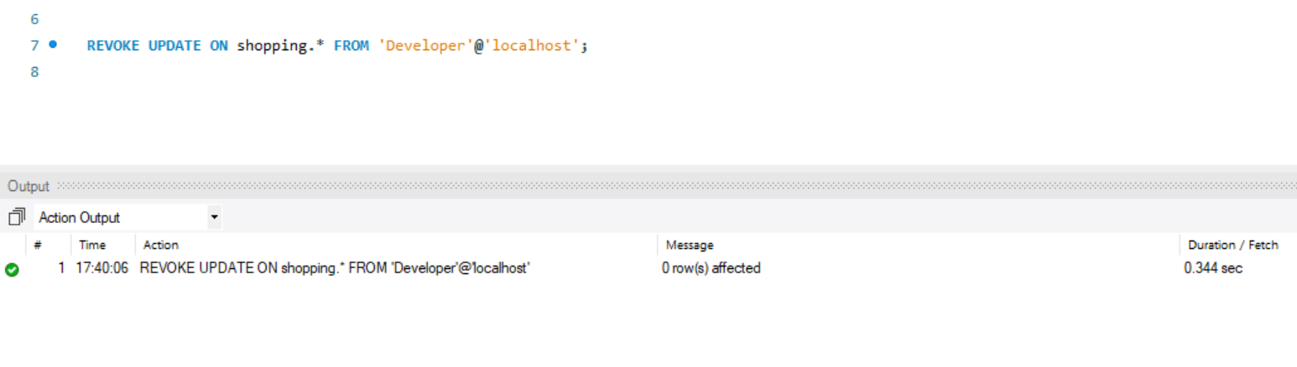
Revoke privileges
This will revoke the permissions given to the user. E.g from below image, we can see that we have revoked the table update privilege from Developer

Slide 23
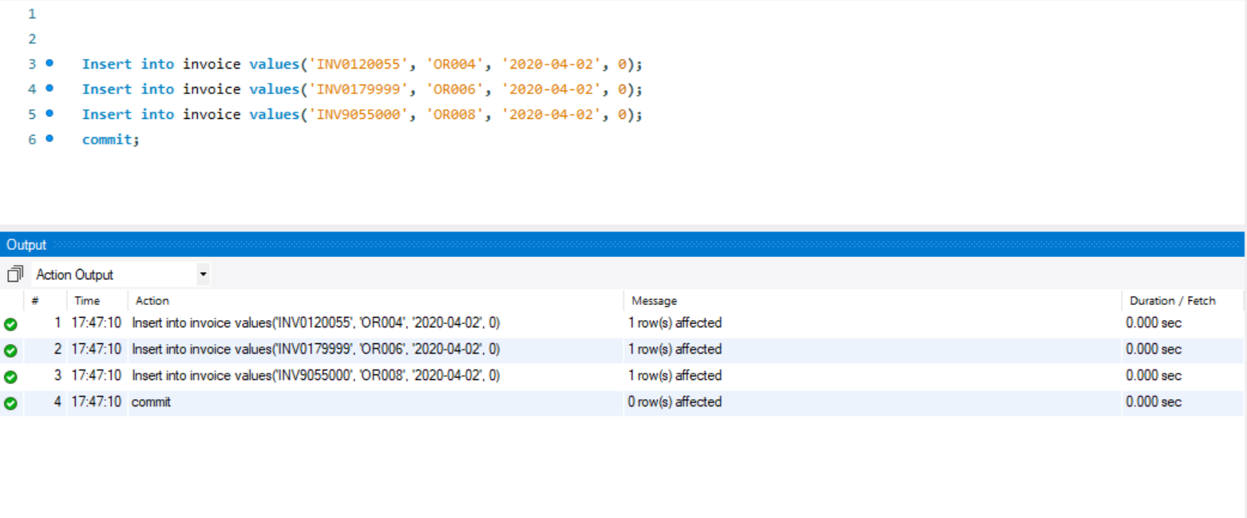
Commit

Slide 24
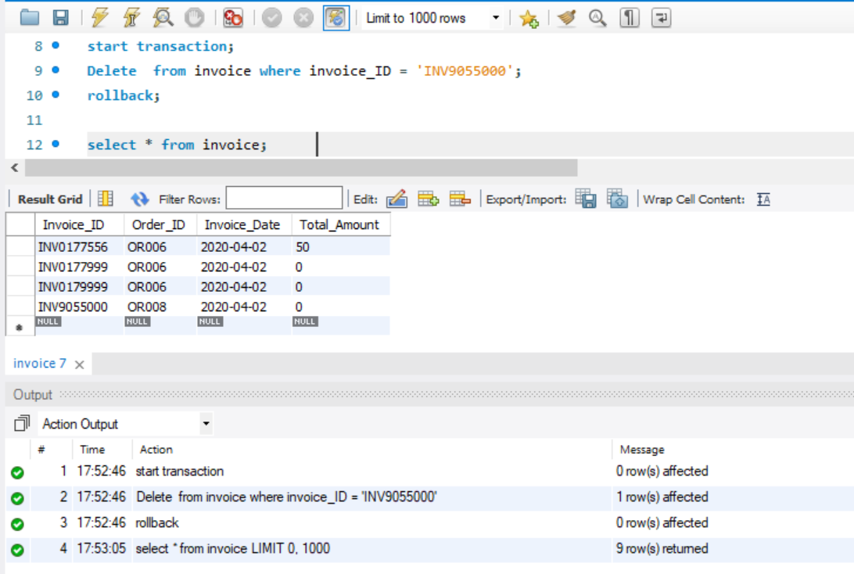
ROLLBACK is the SQL command that is used for reverting changes performed by a transaction. When a ROLLBACK command is issued it reverts all the changes since last COMMIT or ROLLBACK.

Slide 25
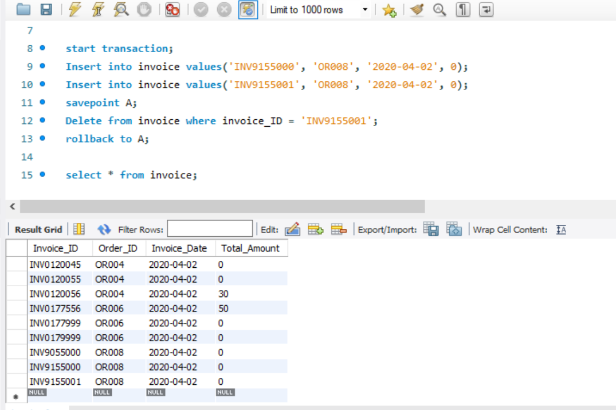
Savepoint
A SAVEPOINT is a point in a transaction in which you can roll the transaction back to a certain point without rolling back the entire transaction.

Slide 26
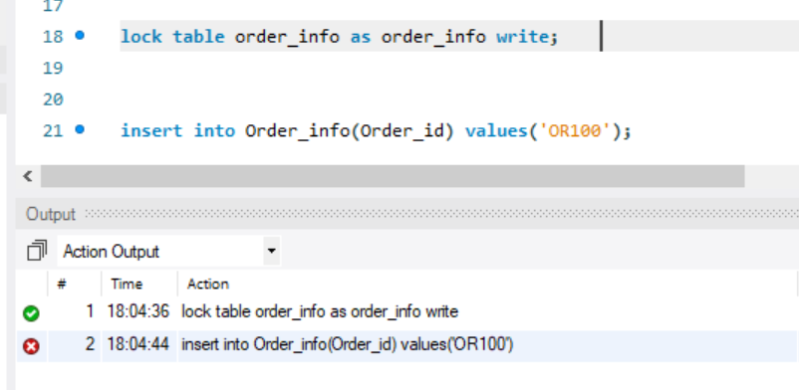
Lock the table

Slide 27
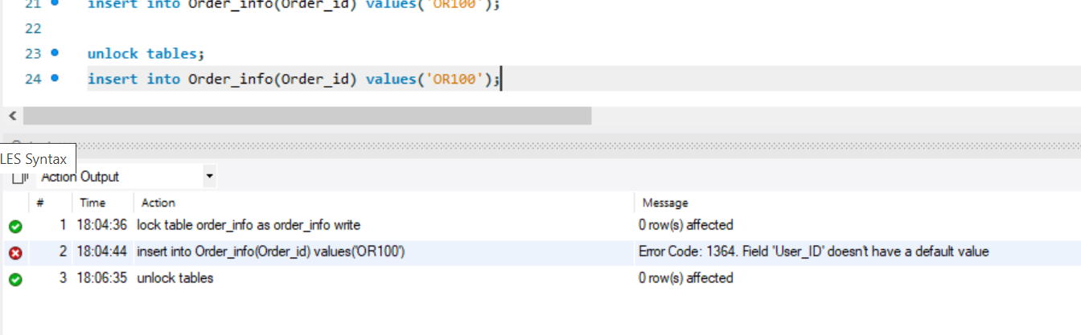
Unlock the tables

Slide 28
Stored Procedures
A stored procedure is a subroutine available to applications that access a relational database management system. Such procedures are stored in the database data dictionary.

Slide 29
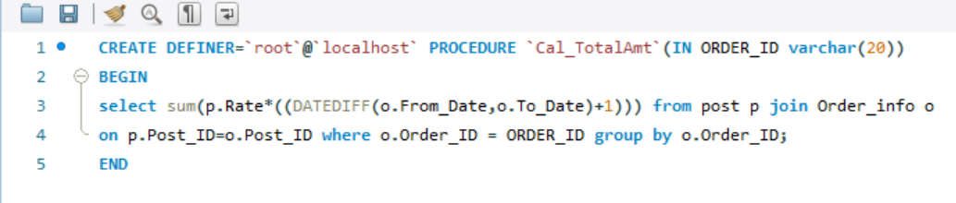

Procedure to calculate total amount
CALL `shopping`.`Cal_TotalAmt`('OR002');

Slide 30
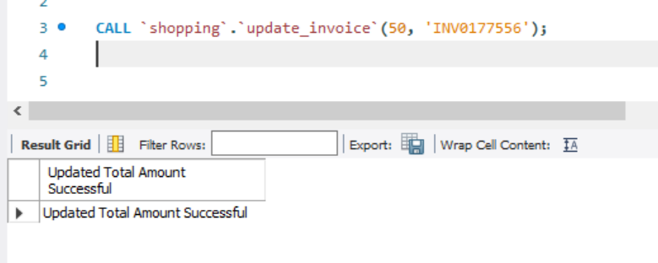
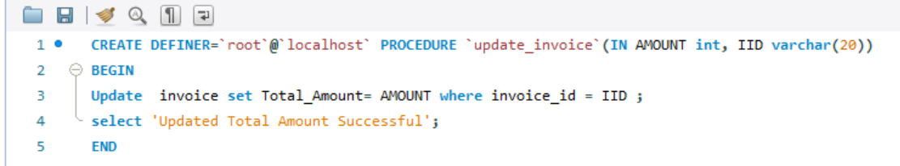
Procedure to update the invoice

Slide 31
Triggers
A trigger is a stored procedure in database which automatically invokes whenever a special event in the database occurs. For example, a trigger can be invoked when a row is inserted into a specified table or when certain table columns are being updated.

Slide 32
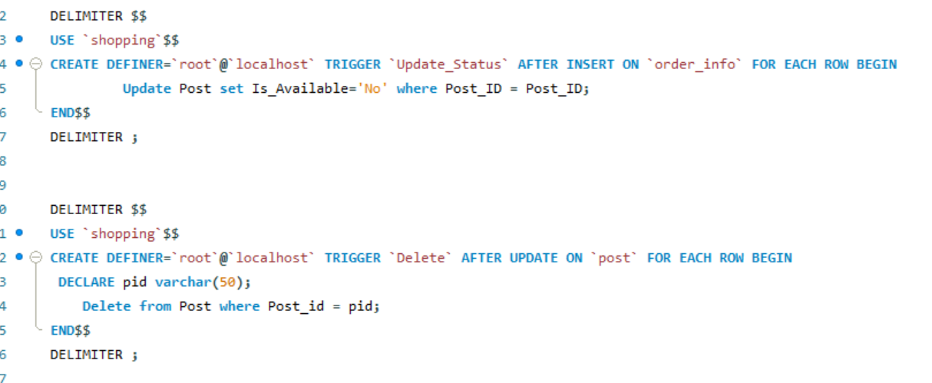
Insert and update trigger

Slide 33
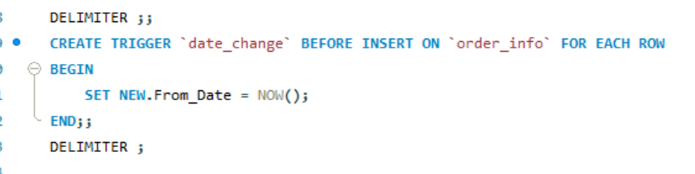
Trigger to set the date

Slide 34
view
In a database, a view is the result set of a stored query on the data, which the database users can query just as they would in a persistent database collection object. This pre-established query command is kept in the database dictionary.

Slide 35
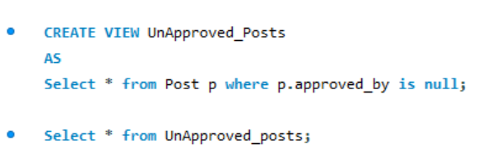
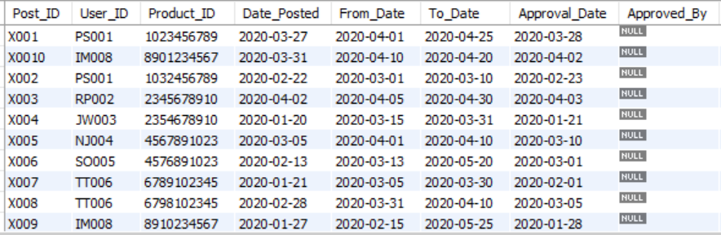
Simple view for unapproved posts

Slide 36
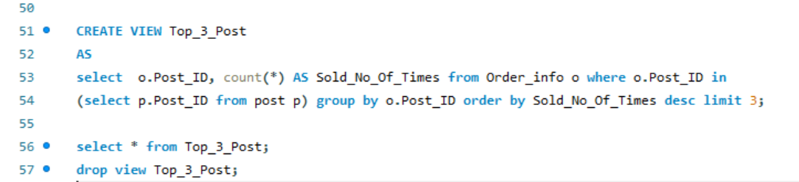
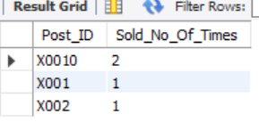
View for top 3 posts

Slide 37
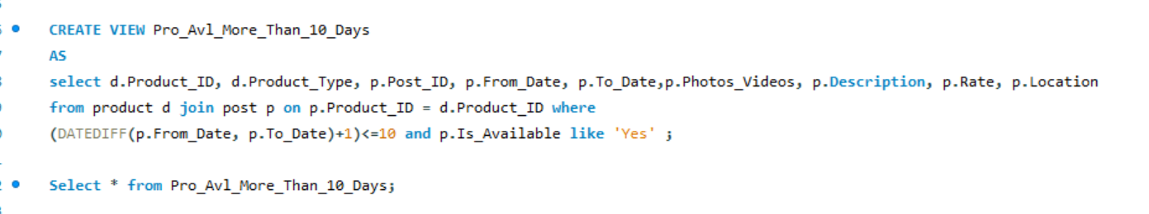
View for product which is available more than 10 days

Slide 38
Backup
What does Backup do?
It copies the data or log records from a SQL Server database or its transaction log to a backup device, such as a disk, to create a data backup or log backup
What is the need for backup?
The main reason for data backup is to save important files if a system crash or hard drive failure occurs. There should be additional data backups if the original backups result in data corruption or hard drive failure.

Slide 39

Types of backups
Full backup A data backup that contains all the data in a specific database or set of filegroups or files, and also enough log to allow for recovering that data.
Partial backup Contains data from only some of the filegroups in a database, including the data in the primary filegroup, every read/write filegroup, and any optionally-specified read-only files.
Log backup A backup of transaction logs that includes all log records that were not backed up in a previous log backup. (full recovery model)
File backup A backup of one or more database files or filegroups.

Slide 40
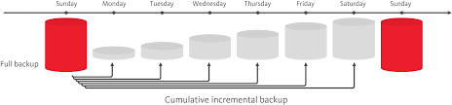
Backup Plan
Lets consider we have to design the backup plan for this online shopping management system. As full back up takes more time and so we want to take full backups only when there is no traffic or when the application is stable.

Slide 41
Citations
https://www.google.com/search?q=sql+backup+plan+example&hl=en&sxsrf=ALeKk01GgUTefoHTGiYBwYsb_bhoHqOPhA:1587331622403&source=lnms&tbm=isch&sa=X&ved=2ahUKEwjtxvmLt_XoAhVAlXIEHToMCZYQ_AUoAXoECAwQAw&biw=1422&bih=678#imgrc=MwxXC9DGMFOFkM
https://app.diagrams.net/#G1mBeNUym173bZGVujCP-rvSH5Bhi0WJPn
https://www.geeksforgeeks.org/sql-tutorial/

Slide 42

Thank you !

